Slide 1

CMR COLLEGE OF ENGINEERING & TECHNOLOGY
Kandlakoya, Medchal, Hyderabad - 501401
Department of Computer Science and Engineering
Personal Assistant
Name of the students
21H55A0517-P.Swetha
21H55A0521-S.Bhavana
21H55A0522-S.Kiran
Under esteemed guidance of
MS.Kavya
Assistant Professor

Slide 2
ABSTRACT
The main aim of our project is to develop a personal assistant that can take voice inputs and open the official website of CMR College of Engineering and Technology.
The personal assistant will be able to recognize voice commands and navigate to specific subpages of the college's website based on the user's request. This project utilizes speech recognition technology and software development skills to create a convenient and efficient interface for users to access the college's website.
The proposed system will provide a hands-free browsing experience and save time for the user. Overall, this project demonstrates the potential of combining different technologies to create innovative solutions for everyday problems

Slide 3
INTRODUCTION
PolyMa is a Voice Assistant through which we can Access CMRCET Portal directly using Voice Commands.
We can easily access every page and every tab of CMRCET portal with voice commands.
When a user gives exact command, it redirects to the certain web page of CMRCET Website.
If the User command is not identifiable or not Recognized, Assistant asks user to re-tell the Command .There is no Voice Assistant or Chat bot for CMRCET website. So this may act as a chatbot.

Slide 4
CHAT BOT
A conversational agent that interacts with users using natural language.
A Chat Robot is a computer program that simulates human conversation or chat through AI.
It is a service powered by rules and artificial intelligence,that you interact with via a chat interface.

Slide 5
HISTORY
The first Chatbot ever was developed by MIT professor Joseph Weizenbaum in the 1960s.It was called ELIZA.
In the year 2009, a company called WeChat in China created a more advanced Chatbot,Since its launch ,WeChat has conquered the hearts of many users who demonstrate an unwavering loyalty to it.It is a highly thriving social media platform.
Early in 2016 ,we saw the intro of the first wave of artificial data technology in the design of Chatbots.Social media platforms like facebook enabled developers to build a Chatbot for their trademark or service to customers could carry out some of their daily acrions from inside their messaging platform.

Slide 6
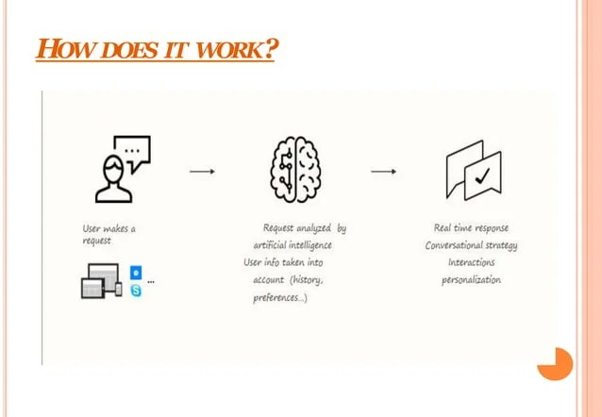
HOW DOES IT WORK?
Looks for certain patterns of words in the user’s input.
Replies with the pre-defined output,if the pattern is matched.
Needs to have an idea of what user will chat.

Slide 7
SYSTEM REQUIREMENTS
Hardware Requirements
Processor-Intel Pentium or higher.
RAM-minimum-> 4GB maximum ->6GB
2. Software Requirements
OS-Windows 7,8,10.
Python IDE must be installed.

Slide 8
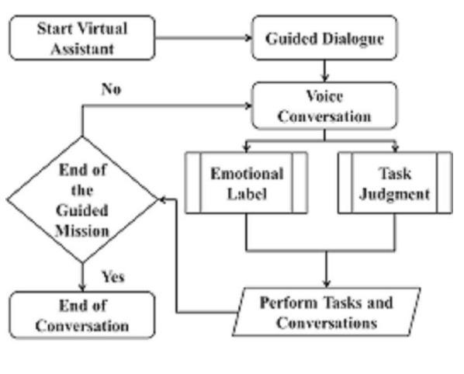
BLOCK DIAGRAM

Slide 9
ALGORITHM
START
---GUIDED DIALOGUE —
LISTEN TO USER COMMANDS —
RECOGNISING THE COMMAND OF USER —
IF COMMAND == TRUE
PERFORM COMMANDED TASK —
ELSE ASK FOR COMMAND AGAIN
[ IF COMMAND IS ABOUT CMR COLLEGE OPEN CMR OFFICIAL SITE ]
IF COMMAND == SLEEP
SLEEP AND WAIT FOR WAKE_UP COMMAND Computer engineering
IF COMMAND == WAKE_UPPERFORM
TASKS ELIF COMMAND == QUIT
COME OUT OF PROJECT AND EXIT
END

Slide 10
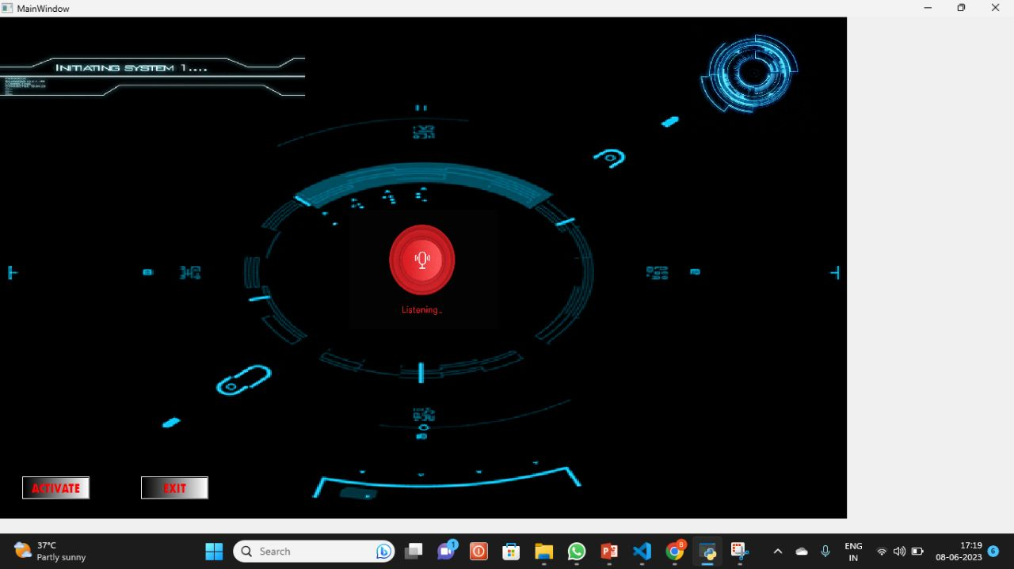

Slide 11
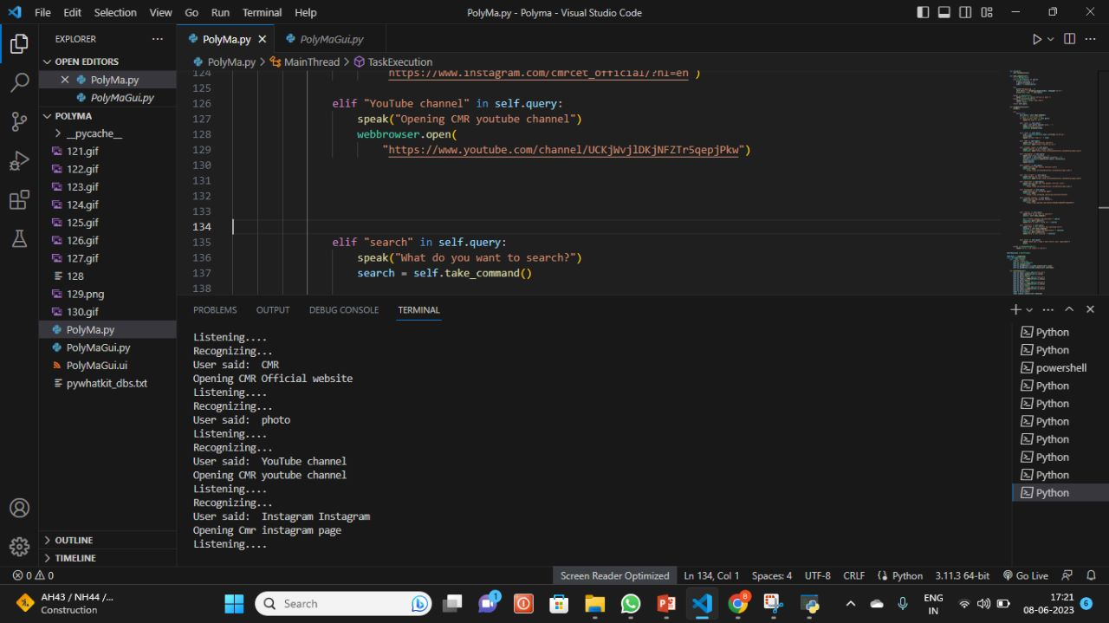

Slide 12
ADVANTAGES
User does not have to go personally to college for enquiry.
This application enables the students to be updated with college cultural activities.
This application helps college management to access every website of college easily.

Slide 13
APPLICATIONS OF A CHATBOT
Accessible any time.
Flexible attribute.
Customer satisfaction
Cost effective.
Faster on boarding.
Personal Assistant.
For more about making your ideas stick with others, check out our book!

Slide 14
LIMITATIONS
Difficult to create..
Require maintain.
It require active internet connection as error may occur.

Slide 15
CONCLUSION
This project aims to develop a personal assistant that can take voice inputs and open the official website of CMR College of Engineering and Technology. The personal assistant will be able to recognize voice commands and navigate to specific subpages of the college's website based on the user's request. This project utilizes speech recognition technology and software development skills to create a convenient and efficient interface for users to access the college's website.
The proposed system will provide a hands-free browsing experience and save time for the user. Overall, this project demonstrates the potential of combining different technologies to create innovative solutions for everyday problems.

Slide 16
FUTURE WORK
In coming time, we could add the other college websites so,that is will be easy to access every college websites.
We can the personal assistant friendly by adding new features so that it will be interactive to users.

Slide 17
REFERENCES
https://www.python.org/downloads/
https://www.google.com/
https://www.jetbrains.com/pycharm/
https://www.microsoft.com/en-us/cortana

Slide 18
THANK YOU

